Slide 1


Store Sales - Time Series Forecasting
. Exploratory data analysis
. Sales Prediction

Slide 2

Sales Analysis isn’t easy!
The supermarkets deals with multiple customers, and it is very important to understand customers behaviors so that the supermarkets can stock the most sold items or goods prior to its unavailability. Unfortunately, there is no reliable way to predict the customer’s behavior. This is a challenge to the supermarket and its partners.

Slide 3
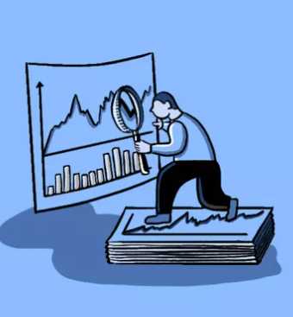
Traditional Sales Analysis
Traditional analysis attempts to predict future sales movements, providing supermarket owners with the information needed to make a profit.
Owners apply Traditional analysis tools to charts in order to identify potential sales and revenue.
An underlying assumption of Traditional analysis is that the market has processed all available information and that it is reflected in the price chart.

Slide 4

Exploratory Data Analysis
Notes:
We are going to show four technical indicators.

Slide 5

Questions to be answered by EDA
Does this type of stores affect the store sales?
Which family has the highest sales?
Does promotion able to improve the sales?
Which city has the greatest number of customers?
Which state has the greatest number of customers?
Which of the stores has the highest sales.
Which month has the most sales, and least sales?

Slide 6
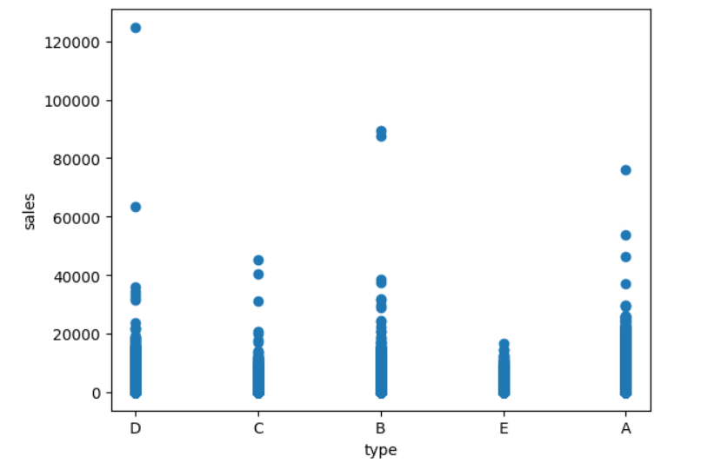
Does this type of stores affect the store sales?
ANOVA (Analysis of Variance) is a statistical test used to determine whether there are significant differences between the means of two or more groups. It compares the variation between the groups (due to the different categories or factors) to the variation within the groups.
H0 (>0.05)= The type of stores does not affect store sales. There is no significant difference in store sales between different types of stores.
H1 (<0.05)= The type of stores does affect store sales. There is a significant difference in store sales between different types of stores.

Slide 7
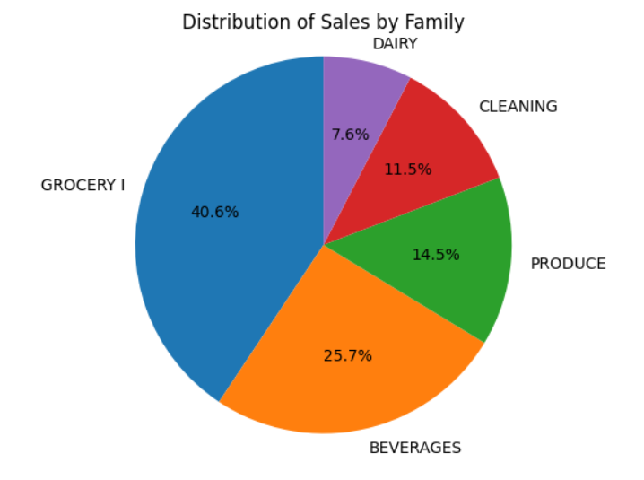
Which family has the highest sales?
Based in the EDA, the GROCERY I is having the highest sales, and Baverages comes second highest.

Slide 8
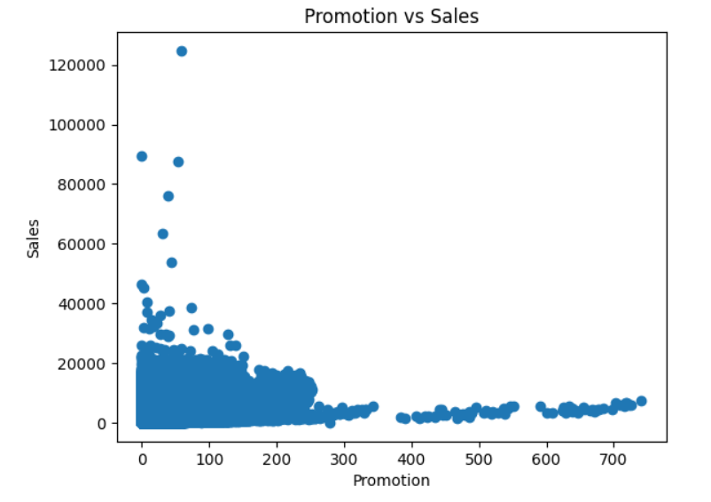
Does promotion able to improve the sales?
Pearson correlation coefficient: 0.42792320481209284
p-value: 0.0
Based on the Pearson correlation coefficient of 0.4279 and the p-value of 0.0, we can reject the null hypothesis (H0) and conclude that there is a significant relationship between promotion and store sales. Therefore, the promotion does affect store sales.

Slide 9
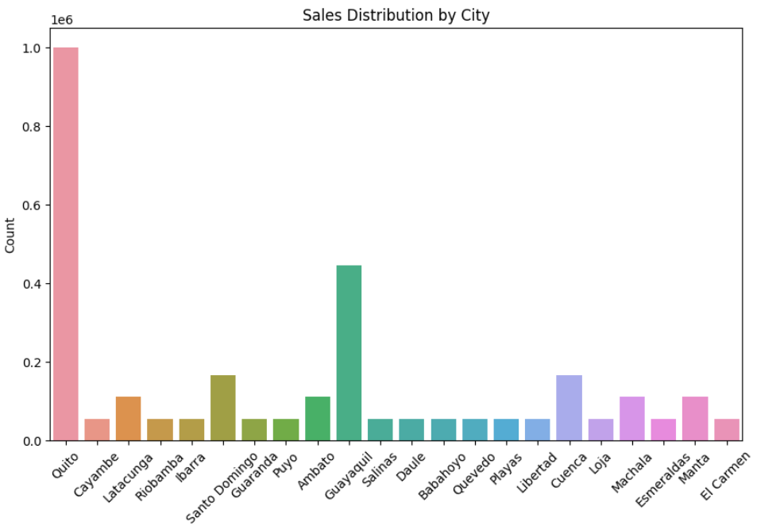
Which city has the greatest number of customers?
Based on the count plot, the Quito city has the most sales.

Slide 10
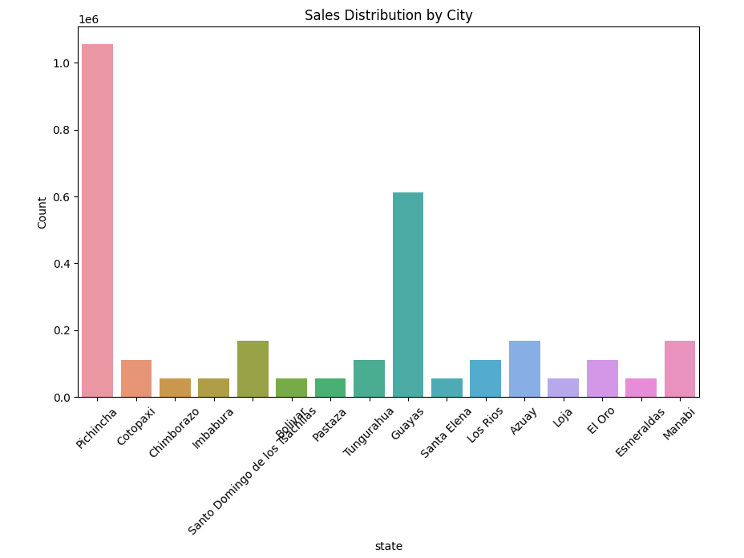
Which state has the greatest number of customers?
Based on the count plot, Pichincha state has the most sales as compared to other states.

Slide 11
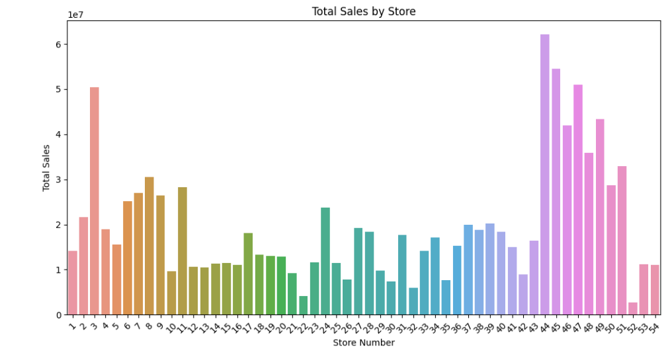
Which of the stores has the highest sales.
Based on the EDA, it shows that store number 44 has the highest sales.

Slide 12
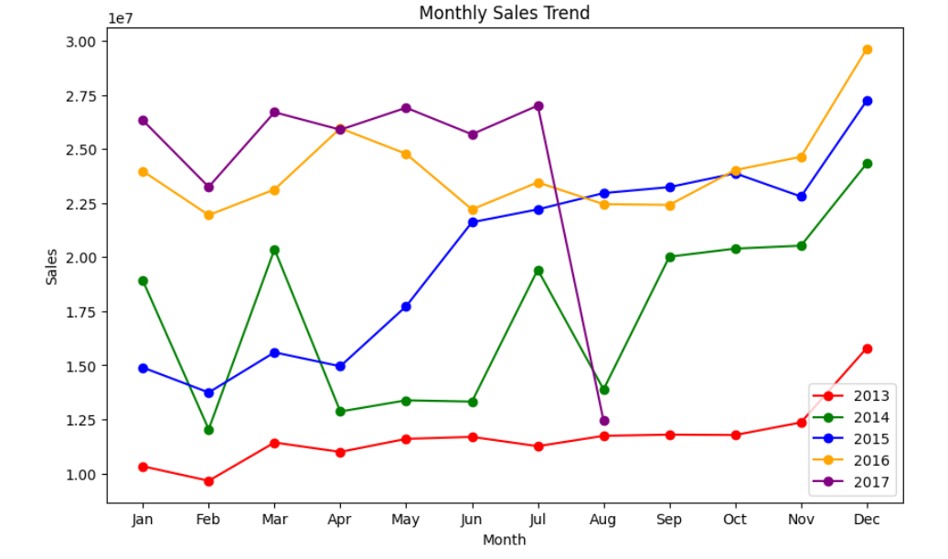
Which month has the most sales, and least sales?
Based on the EDA, the orange line which is 2016 has a stable high sales since January to Dec. Between the months in 2016, December had the most sales. In other hand, in comparing to other years, 2013 had an overall lowest sales achieved, especially during February.

Slide 13
AI/ML ARIMA Model
Notes:
From technical indicators to machine learning. We are going to “teach” a model to predict the value of stock price based on past history. Here, we are going to show you the results of an analysis done using Machine learning

Slide 14
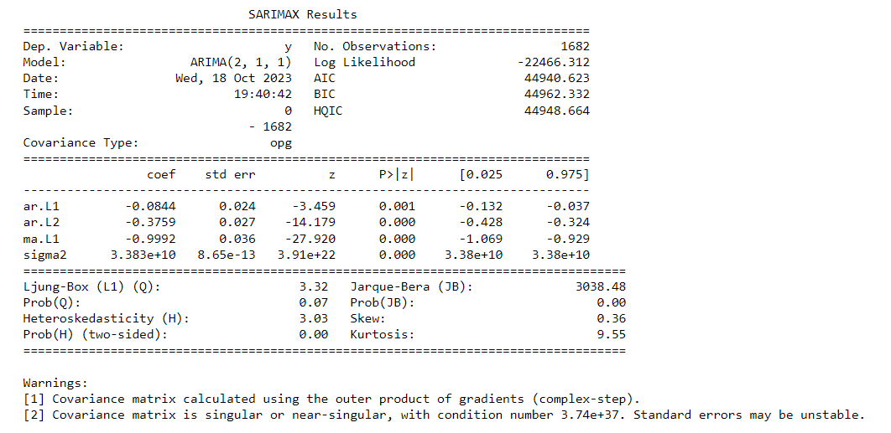
Using ARIMA Algorithm

Slide 15
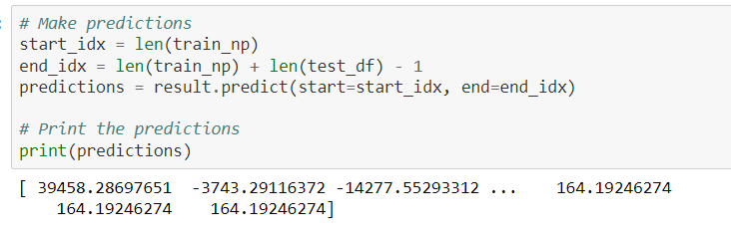
Predictions

Slide 16
Evaluation Metrics
Mean Absolute Error (MAE): 116113.50315596268
Mean Squared Error (MSE): 25441765312.49467
Root Mean Squared Error (RMSE): 159504.7501251755

Slide 17

Next Steps
Build a GUI
Built real-time dashboards
Improve Model Performance
Add classification algorithm(RNN, LSTM)

Slide 18

Conclusions
Supermarket generates huge data everyday. With computing power of AI/ML, we can use that data to make calculated decisions to predict volume of sales effectively.

